Slide 1
Grade 2
Parent Information Session
05/02/2018
This presentation will be posted on Compass under the School Resource section

Slide 2
Welcome (Aaron)
Curriculum in Grade 2
Reading
Writing
Numeracy
Inquiry (Science, Geography & History)
Digital Literacy (Cyber Safety)
Specialist classes
Homework
Year 2 Sleepover
Code of Conduct & Behaviour
Question Time

Slide 3
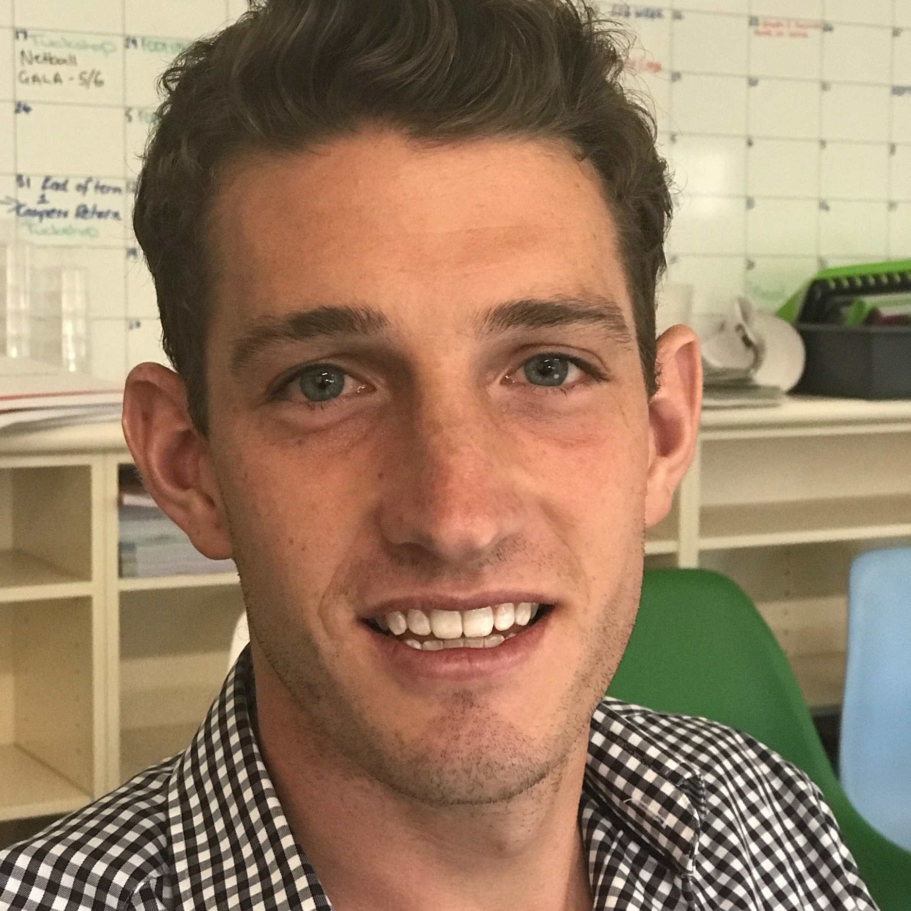
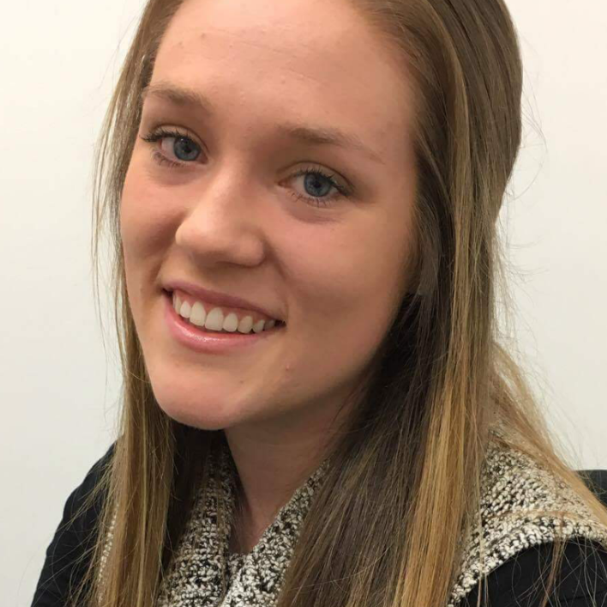
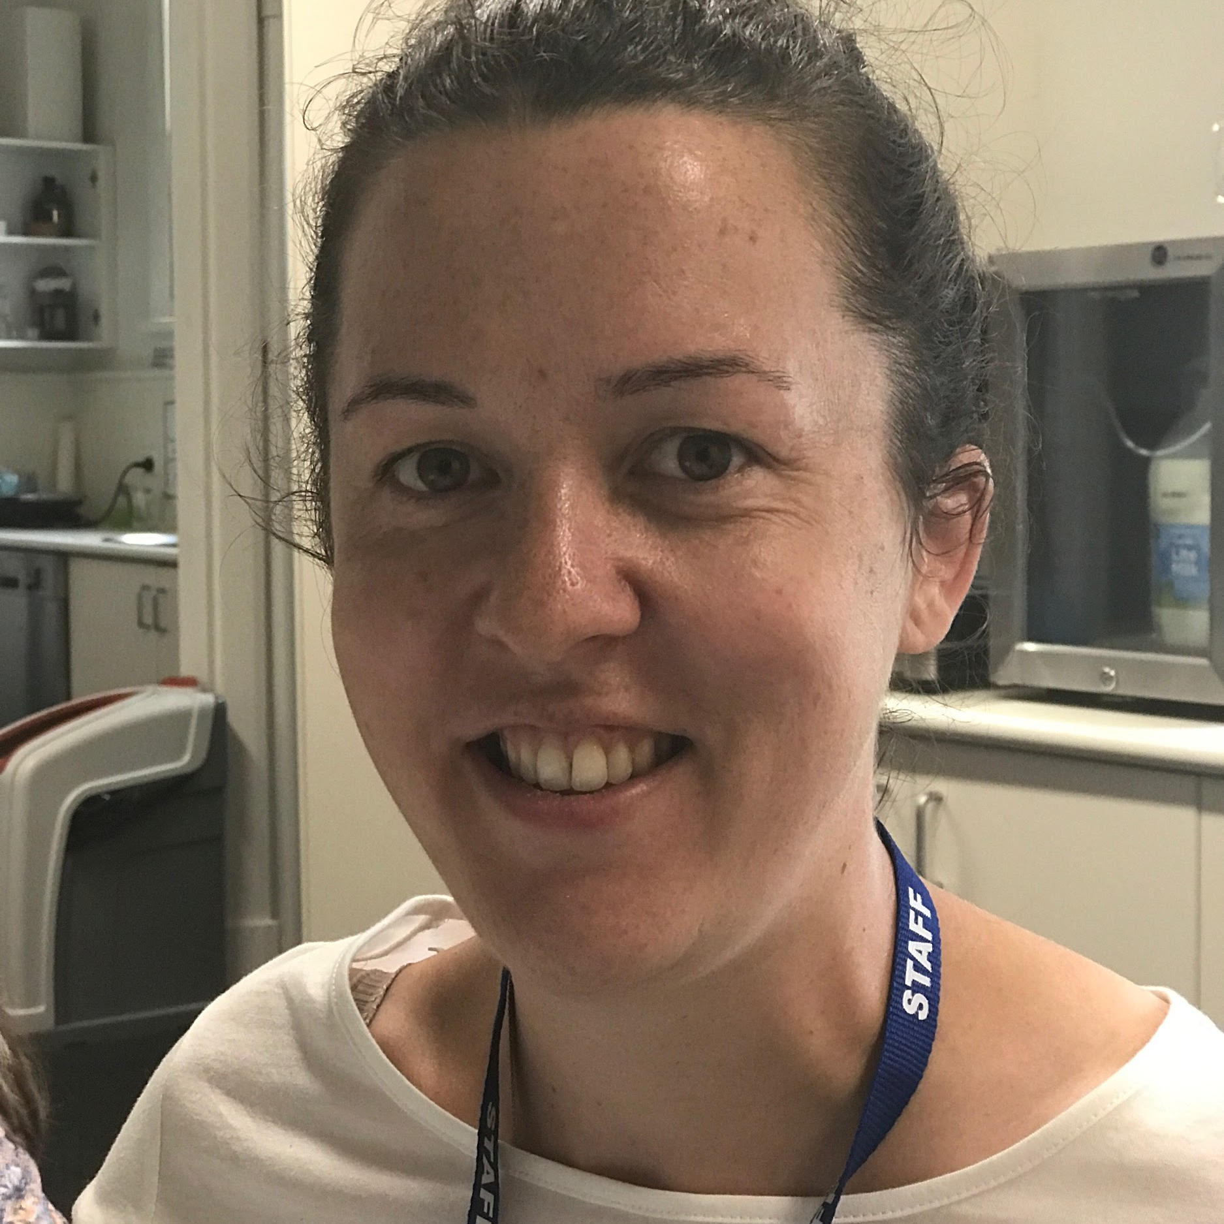
2018 Year 2 Team
Aaron Jones
2A
Brittany Wren
2B
Catherine Segrave
2C
Notes:
These are the people to see regarding any questions or concerns you may have

Slide 4
Curriculum - Reading
(Aaron)
Using the C.A.F.E. Program
Comprehension, Accuracy, Fluency, and Expanding Vocabulary
Reading Groups / Class Novel Reading
Independent Readers
Parent pipelines
Reading Structure:
Five Reading lessons over the course of the week
Focus on two reading genres per term. Term 1 - Information Texts and Recount
Students will continue to access Literacy Planet

Slide 5
Curriculum - Writing
(Catherine)
Writing- Choice Writing, Writer’s Notebook, Genre Focus, Teacher Modelling, Teacher Conference, Author’s Chair
Writing:
V.C.O.P. and Big Write
Skills will include planning, brainstorming, editing, genre structure, self and peer assessment, inspiration for writing
Letters and Sounds Phonics Program (Spelling Program)

Slide 6
Curriculum - Numeracy
(Aaron)
Numeracy structure will consist of:
2 x lessons per week on real life maths investigation
3 x ability based groups
Numeracy will be taught in units where students will work consistently on one concept for a number of weeks
Homework will soon be set from the Number group students are in.
Students will continue to access Mathletics and we encourage your child to explore this valuable resource.

Slide 7
Curriculum - Inquiry
(Brittany)
Focus on Science and History
Integrated into other curriculum areas
Term 1: Mammals and Reptiles - Biological Sciences
Term 2: Birrarung Ramblings - Earth Science and History
Term 3: All Mixed Up - Chemical Science
Asia our neighbours - History and Geography
Term 4: Cardboard Arcade - Physical Science and History
Term 1 Incursion - Lizzy’s Lizards (1st March) more information will be out soon
Time is spent investigating and exploring these topics with each unit culminating in project based work

Slide 8
Digital Technologies (Aaron)
Students will use a combination of iPod Touches, iPads, desktops and laptop computers to identify, represent, and design solutions to simple problems
As part of their learning, students will undertake lessons on how to be safe online

Slide 9
Specialist Subjects
(Catherine)
The specialist subjects for this year are:
Music with Miss Susan Wuttke
Art with Mrs Lynne Ring
Physical Education with Miss White
French with Madame Anderson
Students will continue to attend Library session with their classroom teacher every Tuesday

Slide 10
Homework & Library (Brittany)
It is handed out on Friday and is to be returned by the following Thursday. Homework will begin week 3
Will mainly consist of daily reading.
Take home readers are to be taken home and read every night which will begin in Week 3
Please ensure that reading logs are filled out daily and you are reading with your children every night
Students will require a Library bag to borrow from the library
Only one book may be borrowed at a time
Books can only be borrowed for one week (may be renewed the following week)
Library is on each Tuesday.

Slide 11
Code of Conduct & Behaviour (Catherine)
It is important that every member of the school community understand and become familiar with the code of conduct.
Behaviours and Consequences chart is available online
Hierarchical scale depending on severity of behaviour
Minor incidents -pick up rubbish, walk with teacher
Serious incidents such as refusing to obey instructions, threatening behaviour, destroying property, bullying /harassment lead to a reflection room referral
HEALTH AND WELLBEING
Allergies: Nuts, Sesame and Kiwi Fruit
Bounce Back the Resilience Project
TPS Core Values (Respect, Responsibility, Kindness, Honesty and Friendship)

Slide 12
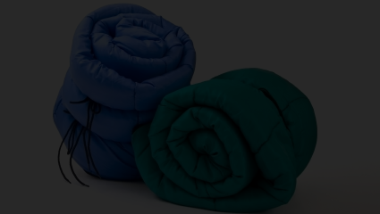
Grade 2 Sleepover (Aaron)
Will be held in Term 4, date TBC.
Basic outline consists of:
Students undertake pre-arranged activities
Parents are asked to collect students early the next day
Further details will be provided closer to the date.
The sleepover is in preparation for camps in Years 3 - 6.
It is highly encouraged that all students attend the sleepover. If you have any concerns please see your classroom teacher or Mr Jones

Slide 13
Classroom Helpers
(Catherine)
You will need to provide the office with a copy of your Working with Children
Answer some simple questions about the Parent Training Sessions webinar on the TPS website
Sign up to the timetable outside each classroom
To volunteer in the classroom, ALL parents helpers need to complete these three steps.
Additionally, each class will need a parent representative to communicate and organise class events with families

Slide 14
Questions
Thank you attending the Grade 2 Parent Information Night. We appreciate your support.

