Slide 1
Term 4 parent
information night

Slide 2
OVERVIEW
Student netbooks - by Rupam Centre Com representative
What netbooks are available for 2019
How do we order netbooks
2. How we use computers in Grades 3-6: Mr. Patterson and Mr. Mooney
What is GAFE?
Cybersafety
3)Sleepover: Mr. Jones, Ms. Segrave and Ms. Wren
Schedule
What to do next
Question and Answer

Slide 3
Student devices for 2019
Rupam from Centre Com

Slide 4
HOW Do we use technology at tps?
3D design and printing
Robotics
Makey-Makey
Animationi
Coding and programming
Website development
Video and Photo Editing
Green screen
Engagement and enrichment for all areas of curriculum
Google Apps
Mr. Patterson and Mr. Mooney

Slide 5
Google Apps for Education (GAFE)
Toorak Primary school is enrolled in a Department of Education and Training (DET) program to access Google Apps for Education.
Both staff and students are involved in this program.

Slide 6
Google Apps For Education (GAFE)
Google for Education (GAFE) is a cloud-based system, offering online productivity tools for classroom collaboration.
GAFE provides students and teachers with unlimited cloud storage in Google Drive, Docs, Sheets and Slides. GAFE also provides student email and other modern online communication tools.

Slide 7
Google Apps For Education (GAFE)
GAFE helps teachers to better differentiate lessons, assists students with learning difficulties, and gives students further opportunities to be extended.
Students with vision impairment can have instructions sent to their individual screens
Students who need support can have additional information given to them in a subtle manner
Students learn to collaborate with students on different devices, different classrooms and even different schools.
Students have access to their GAFE account from any computer or any device.
Students can have access to class work when away, and can catch up on previous lesson topics

Slide 8
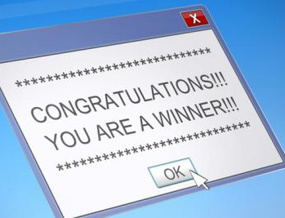
How we stay cyber safe
At TPS:
The school’s network protects students from accessing inappropriate or offensive content.
Education through eSaefty program.
Acceptable use policy:
Device use must be supervised.
Appropriate interaction and communication.
Device is to be used for educational purposes, not entertainment.
At home:
You can contact your Internet Service Provider and they can assist you to limit network access.
Monitor your child’s computer use, particularly when accessing the internet.
Open communication:
Know what your child is doing.
Ensure they are comfortable reporting any suspicious activity to you.

Slide 9
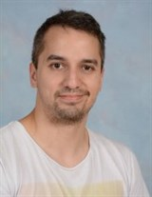
Repairs for netbooks
Repairs & Warranty
Our IT technician, Jason Akers, is able to repair minor issues
He is usually the first point of call
There is a timetable available to book in and see Jason
Any major damage or repairs will be returned to Centrecom for them to fix.
This is included in the 3 year warranty from CentreCom.

Slide 10
Questions?

Slide 11
Sleepover 2018
Grade 2 team

Slide 12
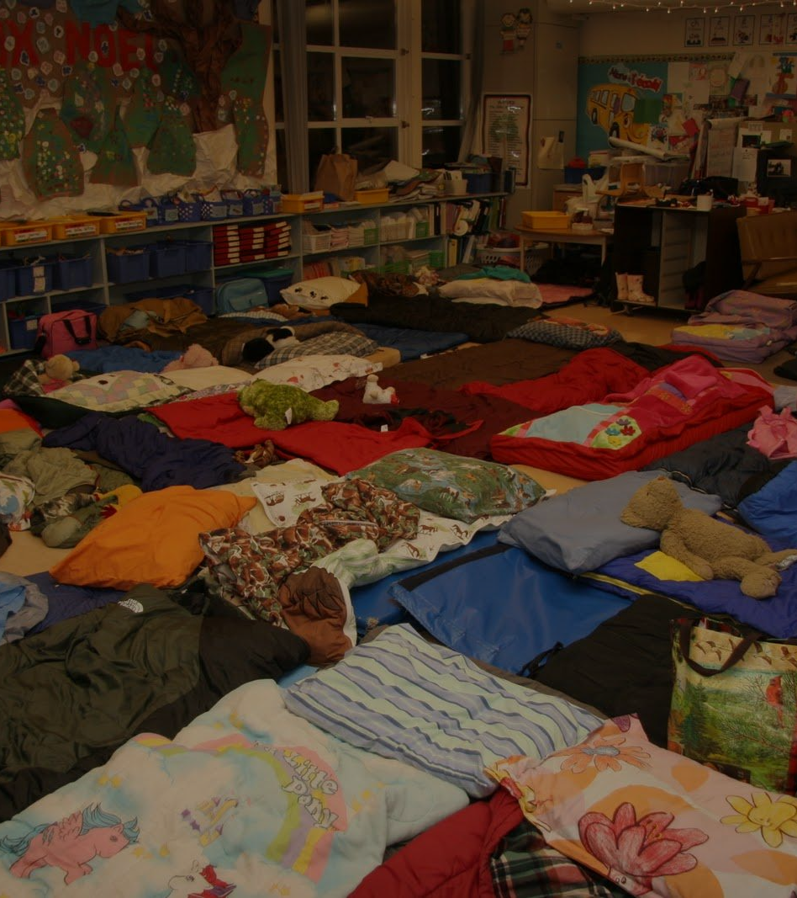
Why DO we HAVE A Sleepover?
The sleepover is aimed at building peer relationships, independence and resilience.
It will provide students with an enriching, rewarding, enjoyable and memorable experience, and will help prepare them for camp programs held in the future years of schooling.

Slide 13
Basic Schedule
Friday 7th December: 6:30pm: Students arrive (students to have eaten dinner before arrival) - Parents can assist with setting up bedding.
6:45pm: Parents say last ‘goodbye’ to children
7:00pm: Students rotate between 3 party game activities
7:40pm: Movie commences
9:00pm: Movie finishes. Students to prepare for bed (brush teeth etc)
9:15pm: Lights out Saturday 8th December: 7:00am: Serve breakfast. Choice of cereal or toast. 8:00am Parents to pick up their child promptly.

Slide 14
TPS will send home the paperwork needed to run the Sleepover including:
- Permission Form
- Medical form outlining any issues to address
- A what-to-bring list

Slide 15
Questions?

